Slide 1
Data Visualization & Analysis Of retail sales Technique Used: recommender system
PREPARED BY:
REEKA HAZARIKA

Slide 2
OBJECTIVEs:
A leading Retailer,
1.Wants to analyse the yearly & monthly transactions and keep a track of its customers spread across various locations along with their purchases/returns across various product
categories.
2. Wants a product popularity based system targeted at new customers.
3. Recommend items to users based on purchase history and similarity of ratings provided by other users who bought items similar to that of a particular customer.

Slide 3
Contents:
Customer information including demographics.
2) Transactions done by customers from period January 2011 to December 2014.
3) Product information.

Slide 4
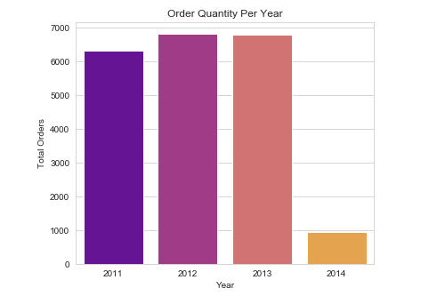
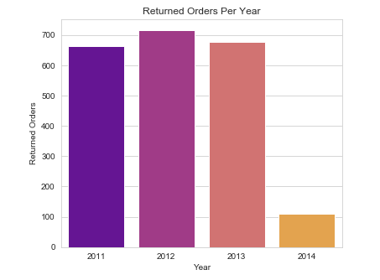
ORDERS PER YEAR (2011-2014):

Slide 5
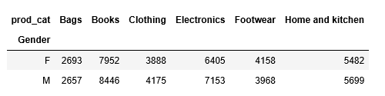
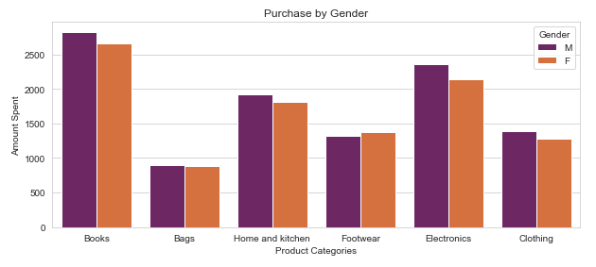
Purchases per Gender:
Men were higher purchaser compared to women except for bags and footwears.

Slide 6
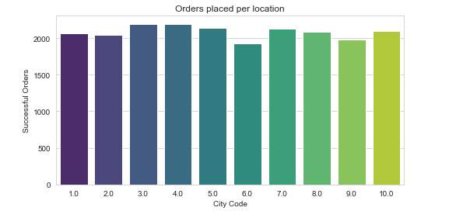
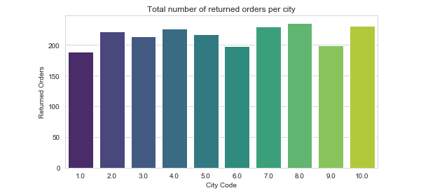
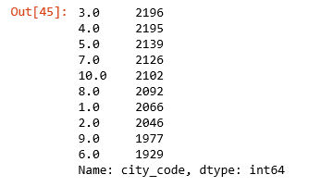
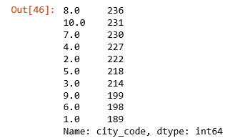
Orders per location:
Total Successful Orders per City
Returned Orders per City

Slide 7
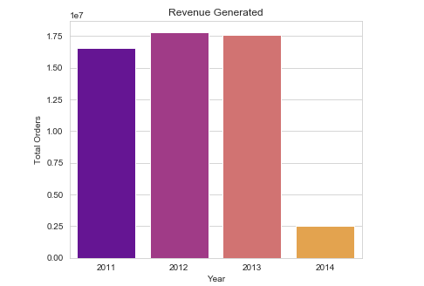
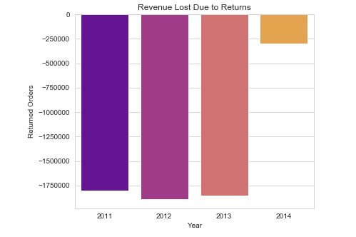
Revenue per Orders:

Slide 8
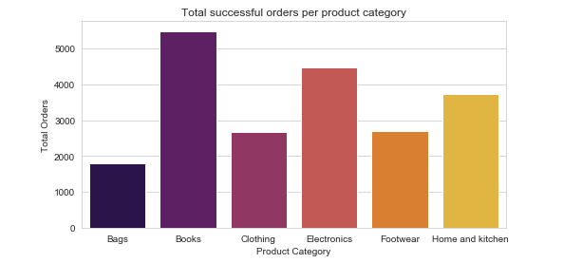
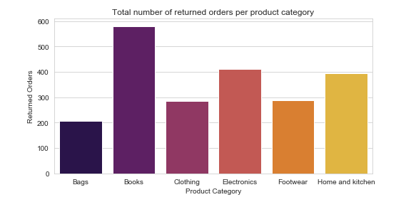
Orders per product category:
Total Orders per Product Category
Returned Orders per Product Category

Slide 9
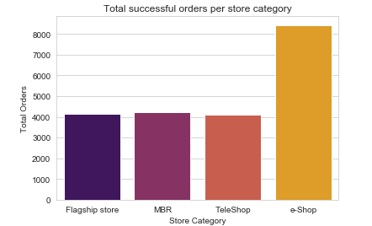
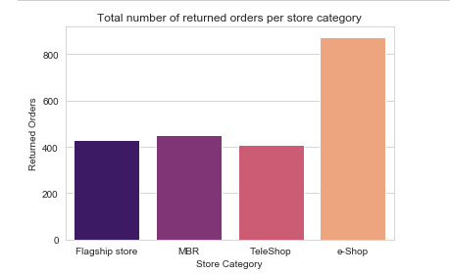
Orders per store category:

Slide 10
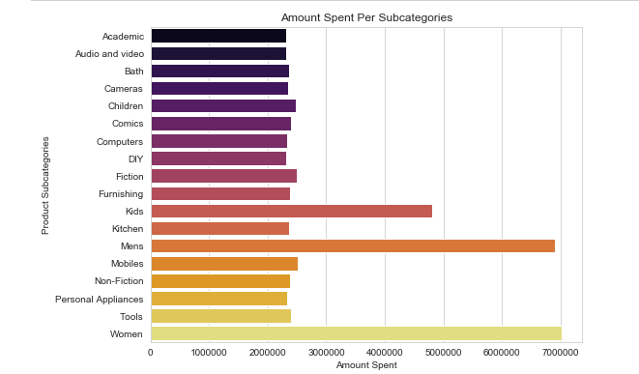
Orders per Product subcategory:

Slide 11
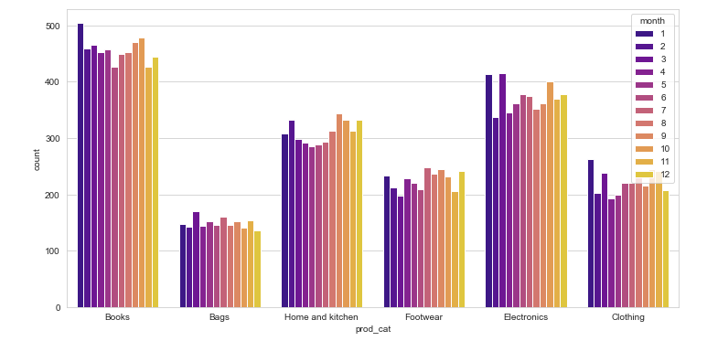
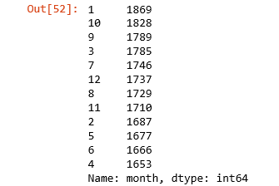
Category Sales per month:

Slide 12
Data Visualization:
1) Highest Sales was recorded in the years 2012 and 2013 and 2012 has the highest returned orders.
2)Men were higher purchaser compared to women except for bags and footwears.
3)The highest sales were recorded in city codes 3 & 4 and the lowest in City code 6.
The city with the highest returns is city code 8.
4)The highest revenue generated was in the year 2012 and the highest revenue lost
was also in the same year 2012.
5) Purchases were largely made online ,with e-shop also accounting for the most returns.
6)Product Categories: Books, Electronics and Home & Kitchen accounted for the
most sold and most returned.
7)Considering subcategories: Women, Men and Kids products sold more than the rest.
8)The most sales were recorded in the month of January.

Slide 13
Recommender system

Slide 14
Recommender system part I:
Product popularity based system, targeted at new customers.

Slide 15
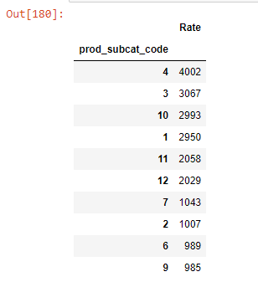
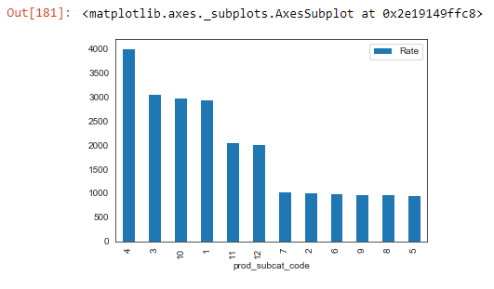
Analysis:
The graph gives us the most popular products (arranged in descending order) sold by the retailer. For example, product ID (prod_subcat_code) # 4 has number of ratings of over 4000, the next most popular product ID (prod_subcat_code) # 3 has number of ratings of 3000 etc.

Slide 16
Recommendation System - Part II
Model-based collaborative filtering system

Slide 17
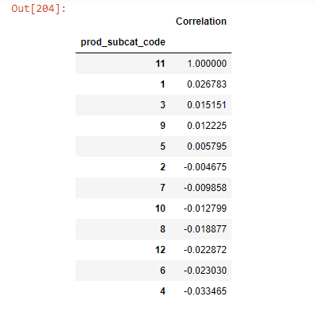
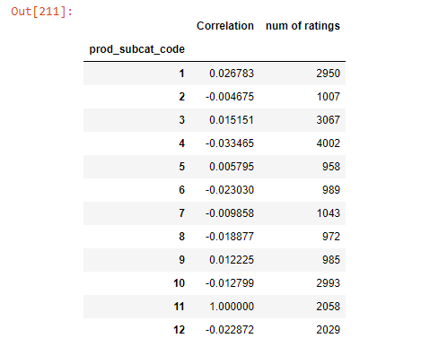
Once, the customer makes a purchase, the recommender system updates and recommends other products based on the purchase history and ratings provided by other users.
In the below screen shot, based on the product the customer had purchased (i.e. product_subcat_code=11), recommender system has suggested other similar products using Correlation matrix. As per recommender system suggestion, product code#1 & 3 are similar to product code#11. Below are also given the product code with number of ratings, the number of rating for product code#11 is 2058 and that of product code#1 is 2950 which are almost similar.

Slide 18
Thank you

